Slide 1
Coherent encoding of subjective spatial position in visual cortex and hippocampus
Aman B. Saleem, E. Mika Diamanti, Julien Fournier, Kenneth D. Harris & Matteo Carandini
Nature, 2018

Slide 2
Introduction
Navigation is strongly driven by vision.
Activity of HC and V1 neurons has been shown to co-fluctuate during navigation.¹
Are visual responses selective for locations in allocentric space?
1. Haggerty & Ji, 2015

Slide 3
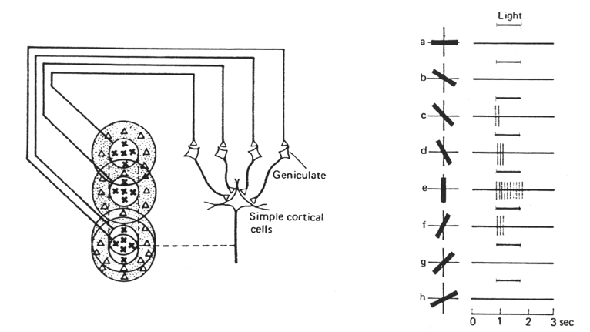
Receptive Fields in V1

Slide 4
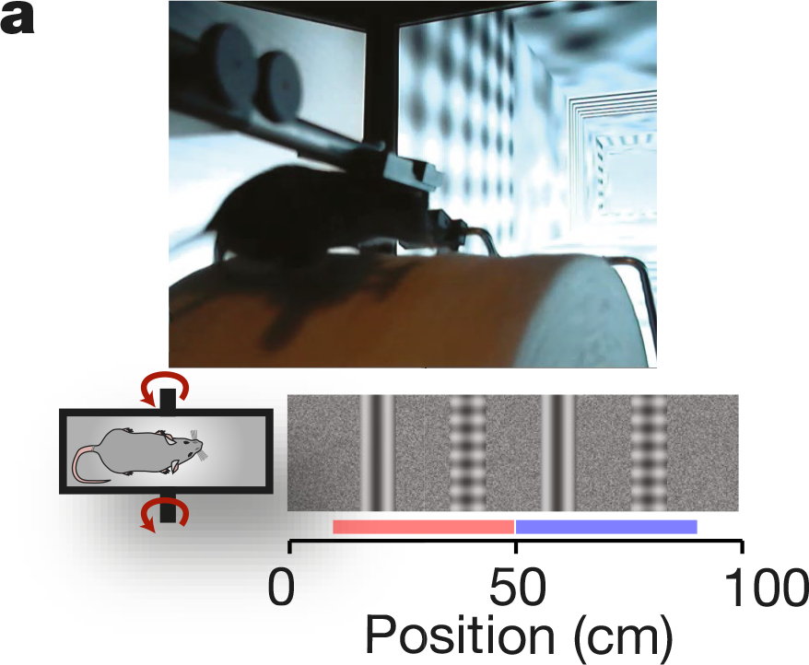
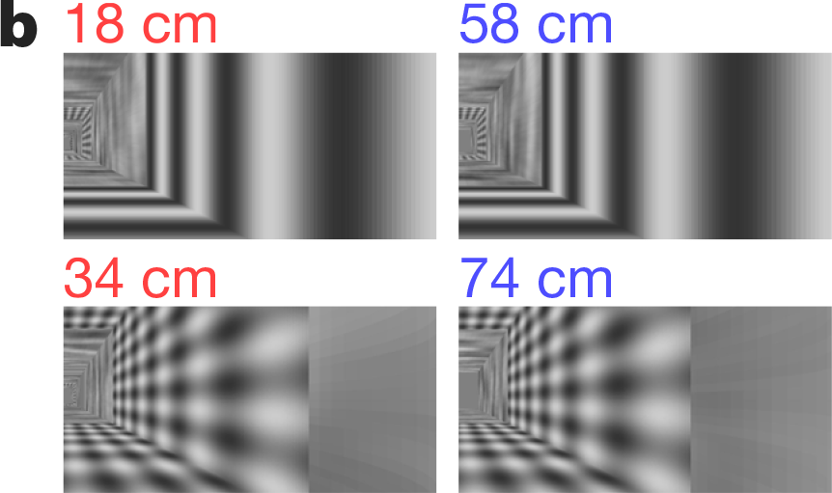
Task Design

Slide 5
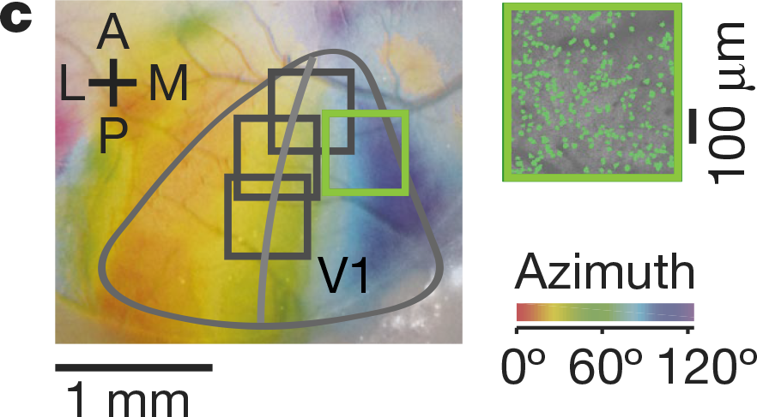
2-photon Imaging
Notes:
To measure retinotopy we presented a 14° wide vertical window containing a vertical grating (spatial frequency 0.15 cycles per degree), and swept37,38 the horizontal position of the window over 135° of azimuth angle, at a frequency of 2 Hz. Stimuli lasted 4 s and were repeated 20 times (10 in each direction). We obtained maps for preferred azimuth by combining responses to the two stimuli moving in opposite directions, as previously described37

Slide 6
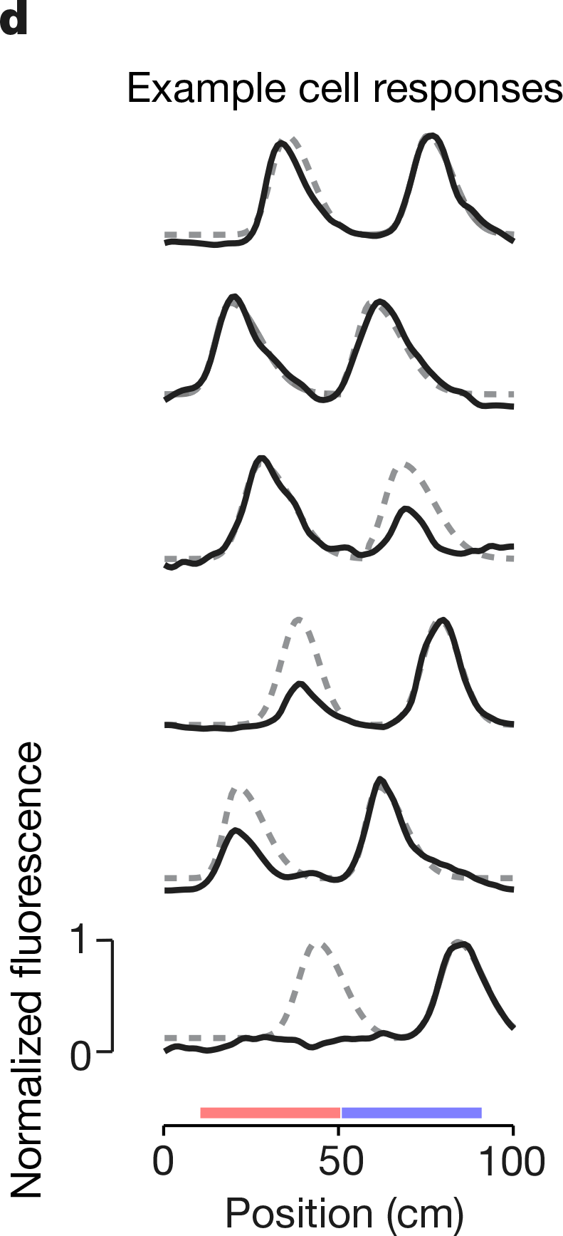
Position coding in V1
Neurons showed different responses to identical visual stimuli, depending on position of encounter.

Slide 7
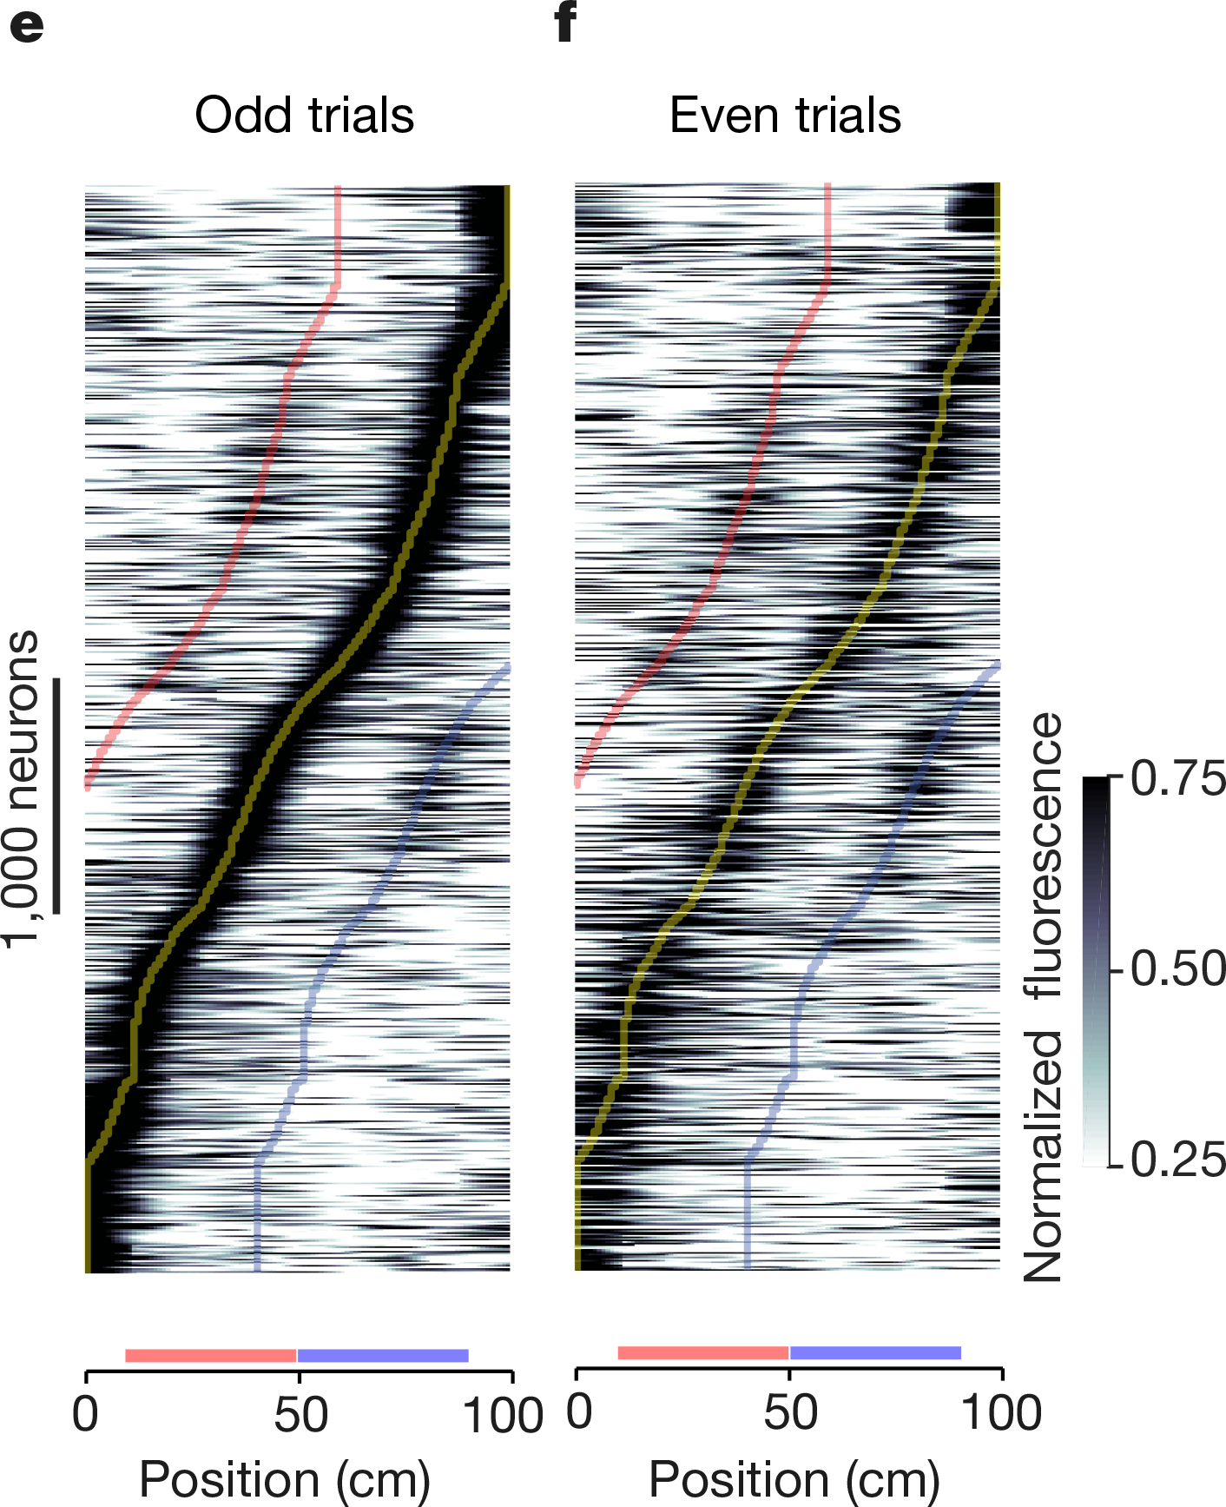
Position coding in V1
Neurons showed different responses to identical visual stimuli, depending on position of encounter.
Notes:
Neurons are ordered by the position of their maximum response. f, As in e for even trials. Curves indicate preferred position (yellow) and preferred position±40 cm (blue and red)
e,f show 4,958 neurons averaged across odd or even trials.

Slide 8
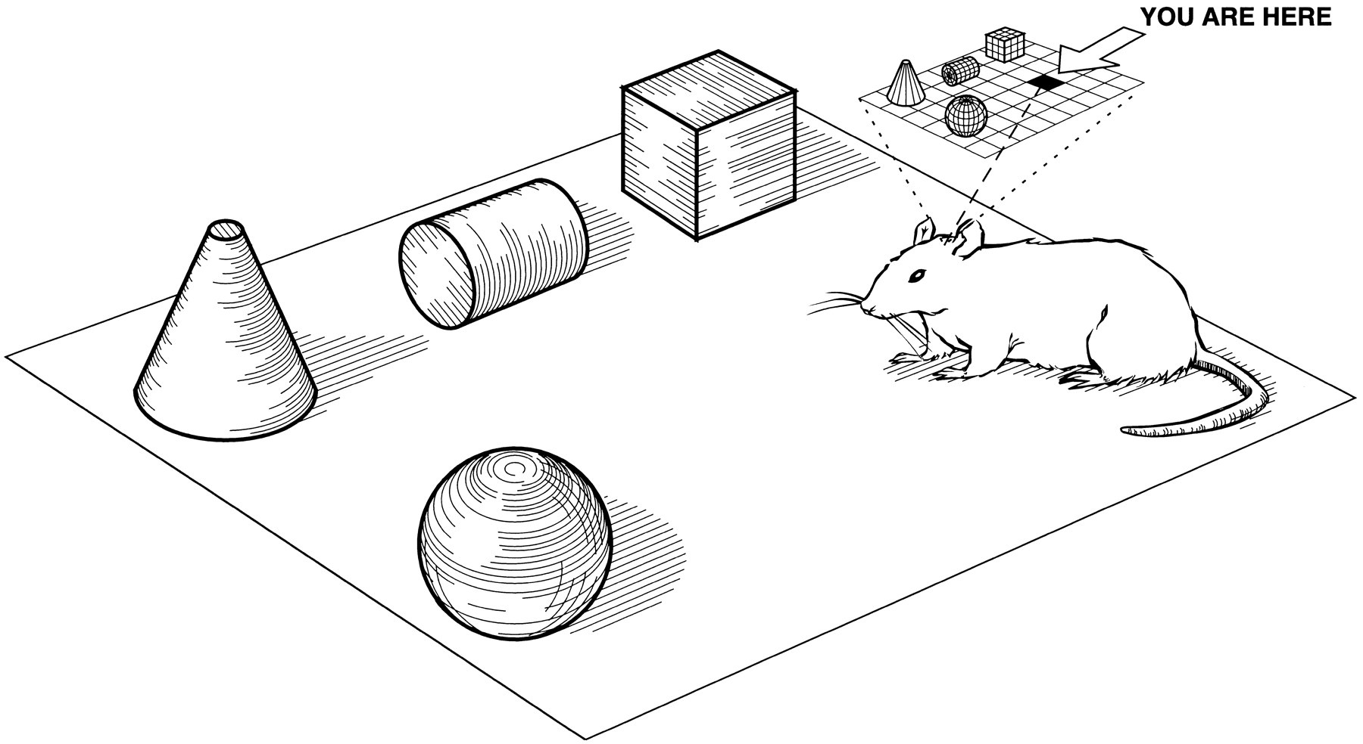
V1 responses driven by hippocampus?
The observed selectivity could be based on V1-local computations.
But what if they are driven by hippocampal cognitive maps?
Image from Eichenbaum et al., 1999
Notes:
Neurons are ordered by the position of their maximum response. f, As in e for even trials. Curves indicate preferred position (yellow) and preferred position±40 cm (blue and red)
e,f show 4,958 neurons averaged across odd or even trials.

Slide 9
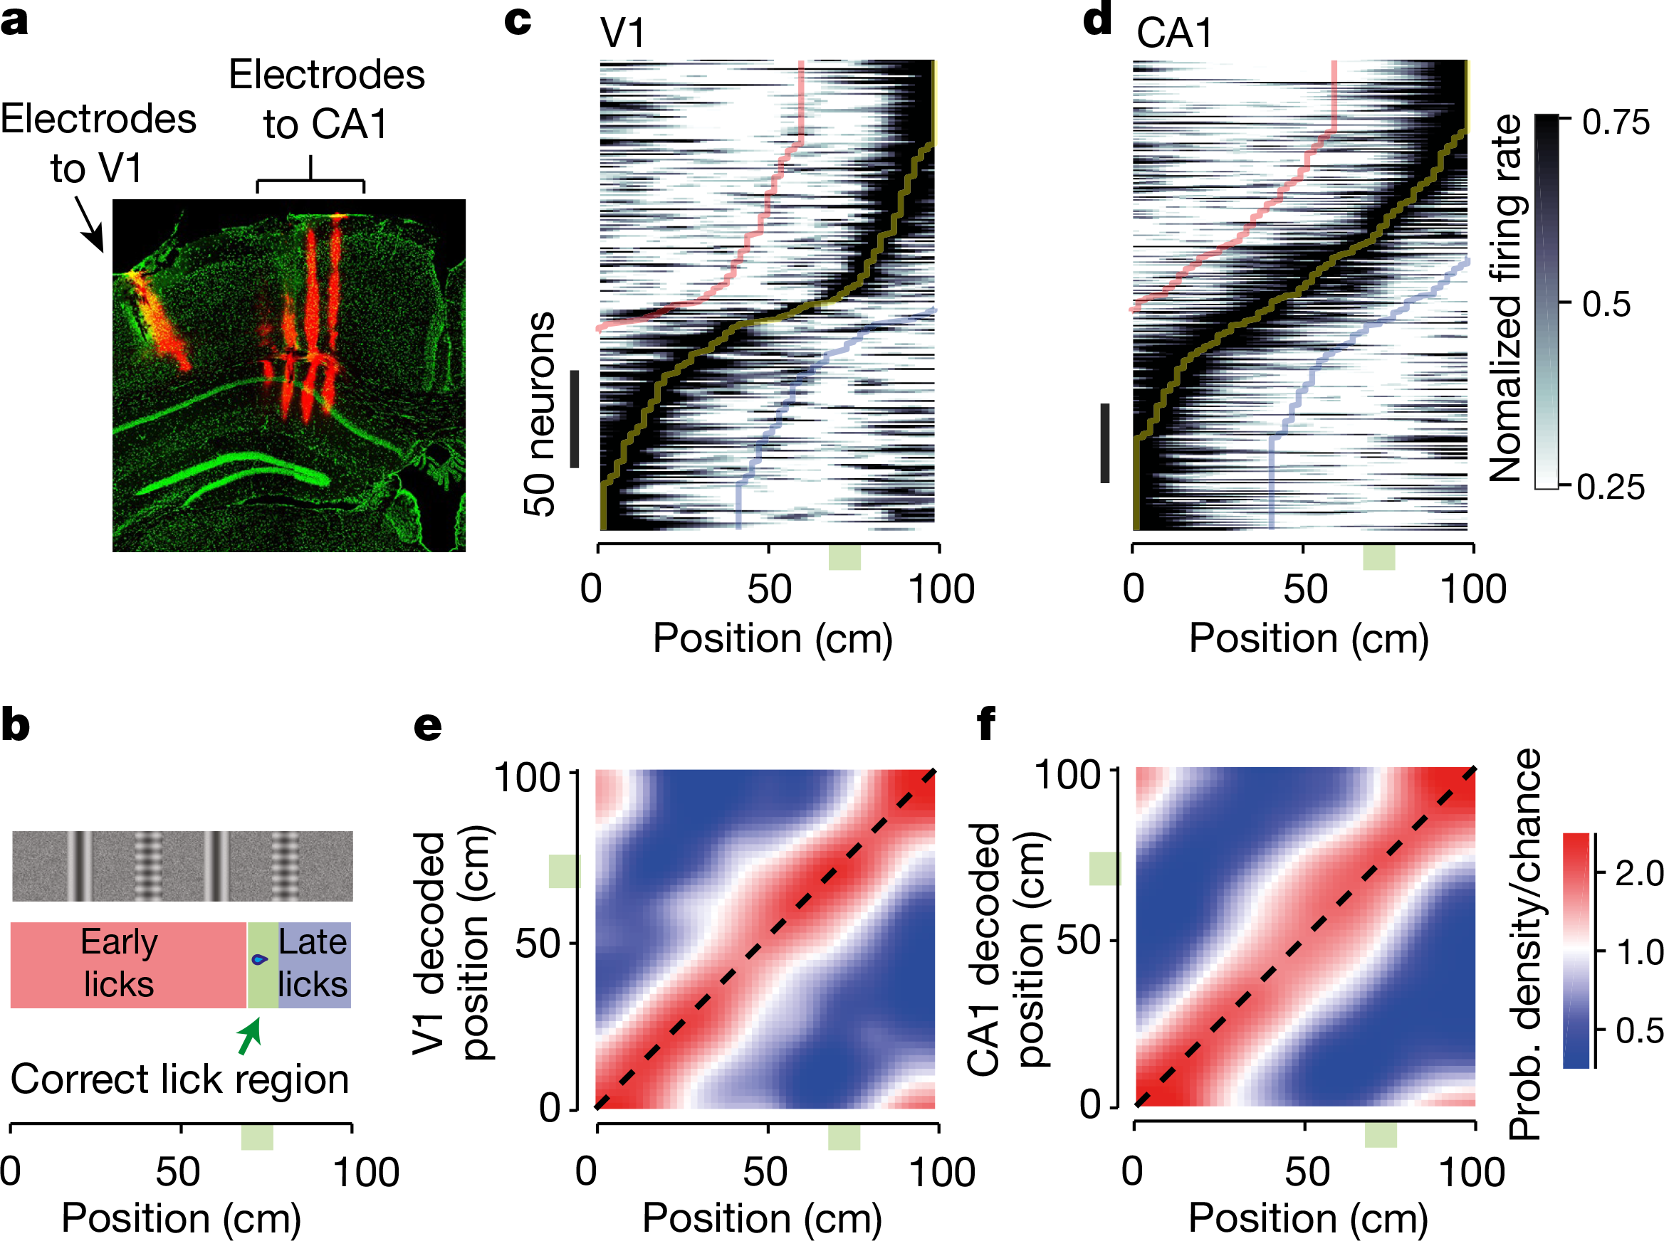
CA1→V1
Notes:
To decode position, we need neural data at higher temporal resolution
E and f show decoded position averaged across 8 recording sessions, and considering only correct trials.

Slide 10
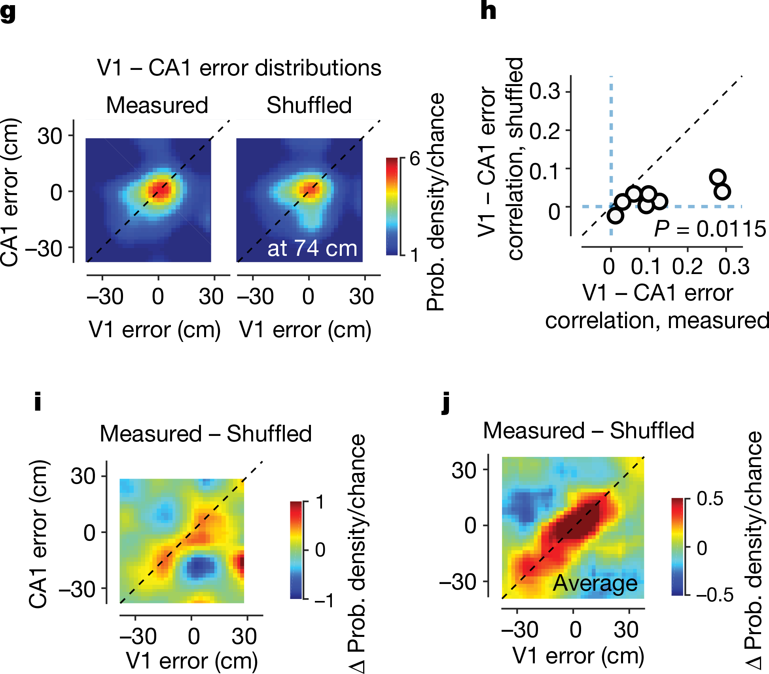
Speed Confound?
Timepoints were shuffled across sessions, while preserving position and speed.
Notes:
Before shuffling: At position 50 cm on trial 1, V1 and CA1 are simultaneously recording from the same moment - they're causally linked and can influence each other or receive common input After shuffling: At position 50 cm on trial 1, you might have V1's activity from trial 1 but CA1's activity from trial 5 - they're no longer from the same moment in time, breaking their temporal coupling
Imagine on Trial 1 at position 50 cm:
Speed is 15 cm/s
V1 decodes position as 55 cm (5 cm error)
CA1 decodes position as 56 cm (6 cm error)
Both made similar positive errors
On Trial 5 at position 50 cm:
Speed is also 15 cm/s
V1 decoded as 48 cm (-2 cm error)
CA1 decoded as 47 cm (-3 cm error)
Both made similar negative errors
After shuffling: Position 50 cm on Trial 1 might now have:
V1's response from Trial 1 (error = +5 cm)
CA1's response from Trial 5 (error = -3 cm)
The correlated errors are now mismatched!

Slide 11
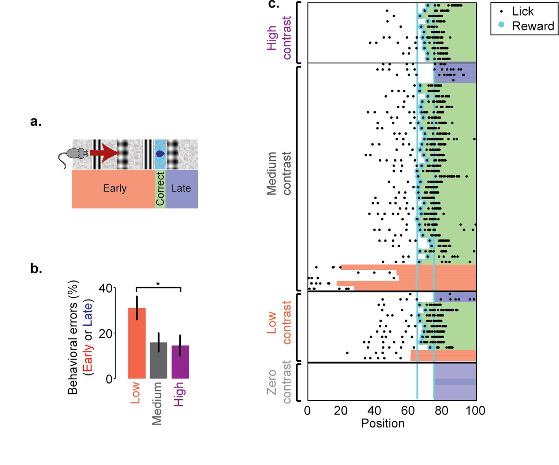
Is the task actually visual?

Slide 12
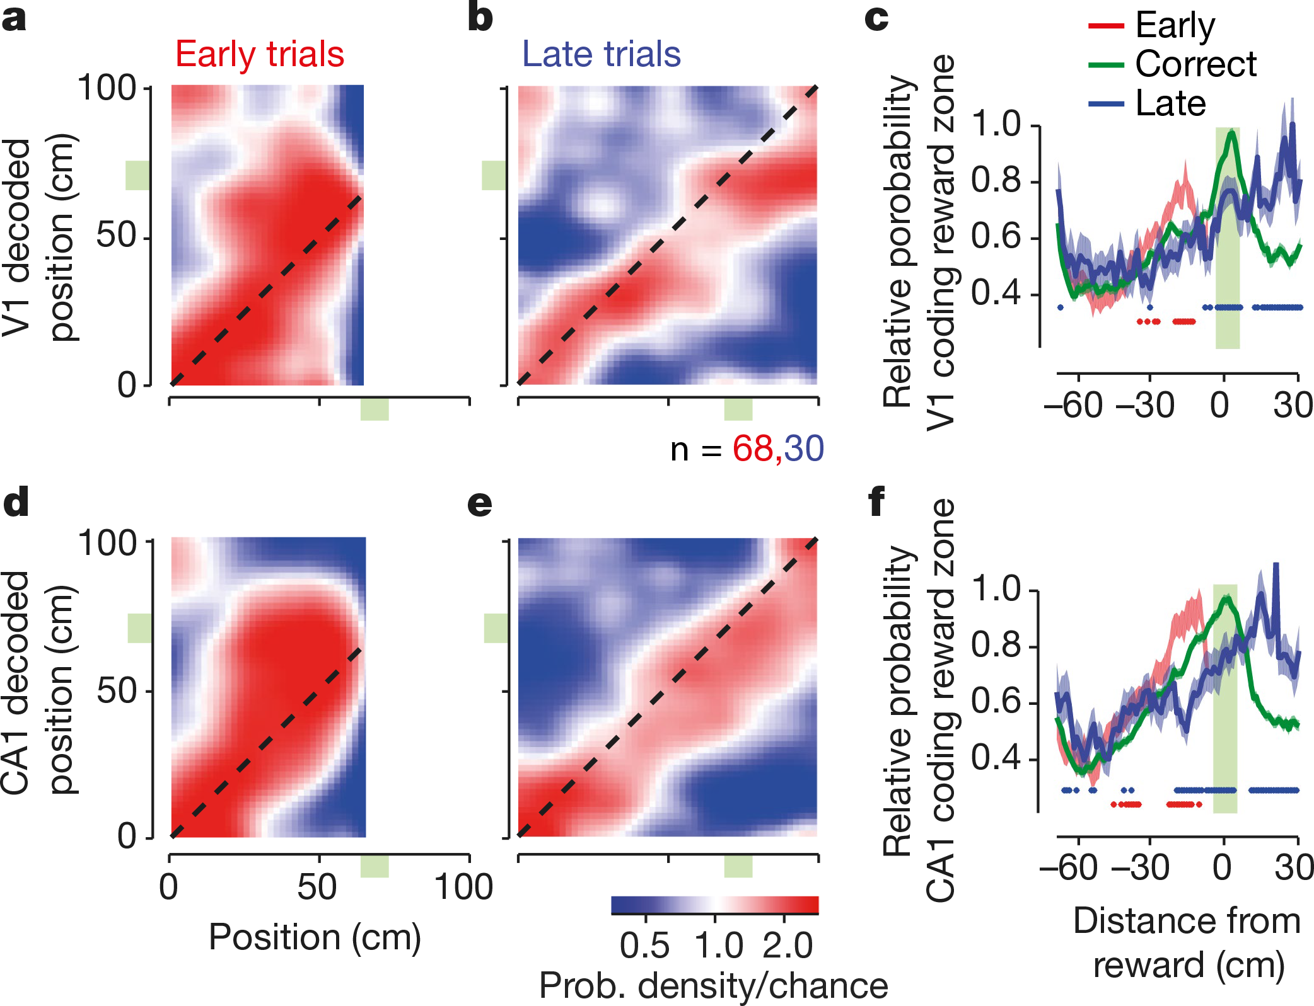
Subjective Position

Slide 13
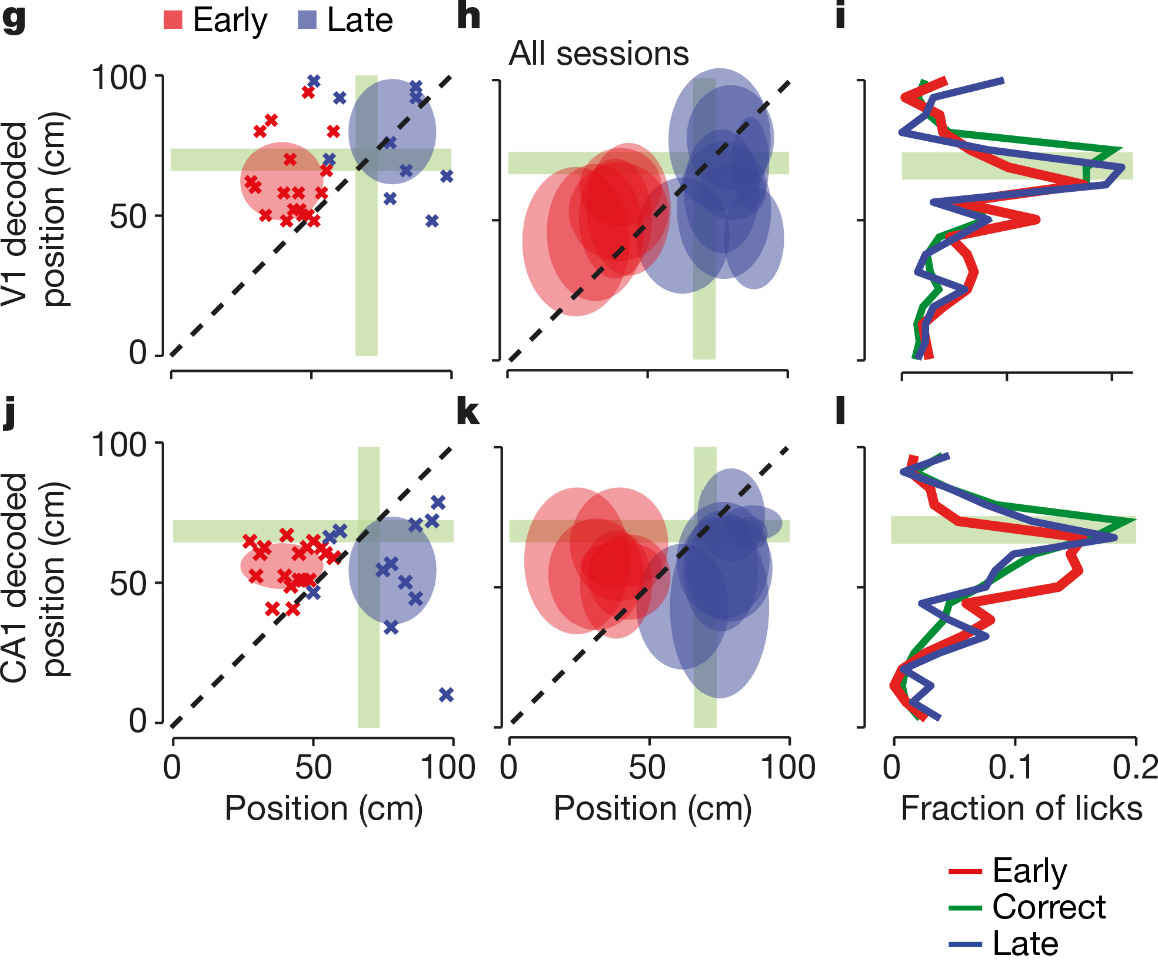
Subjective Position

Slide 14
Questions?
The authors looked at RFs greater than 40° azimuth.
Mice don’t have fovea.
Would we expect similar place-selective properties across the retinotopic field of a primate?
Might peripheral RFs be a special case?
Are V1 neurons selective for object identity in primates?
Notes:
In primates, do RFs become tuned to particular objects?

